Slide 1

Activity: Real Life Scenarios
Overview: In this activity, you will be given a life to ‘play’ – just remember that in the real world you largely decide what life you will have

Slide 2
Determining Education
& Training Level
You are about to be put in a ‘box’ – in other words you’re going to be handed a future that isn’t necessarily yours
The purpose of this activity is to explore the idea to the right
“Education level is directly proportional to your future earnings and lifestyle.”

Slide 3
Monthly Budget
Make sure you have a blank
Monthly Budget Worksheet

Slide 4
Directions
Fill in your name
Record your birth date
Add your birth month and birth day to get a number between 2 and 43
Use the chart on the next slide to record your education level and monthly salary – This information is from the 2000 US Census

Slide 5
Monthly Income
Birth Month + Birth Day = | Education Level | Monthly Income
2-6 | High school dropout | $1679
7-13 | High school graduate | $2045
14-20 | Military | $2305
21-27 | Associate Degree | $2318
28-35 | Vocational | $2442
36-39 | Bachelors Degree | $3181
40-43 | Masters Degree | $3804

Slide 6
Hourly Wages
Birth Month + Birth Day = | Education Level | Hourly Wage
2-6 | High school dropout | $10.50 per hour
7-13 | High school graduate | $12.78 per hour
14-20 | Military | $14.40 per hour
21-27 | Associate Degree | $14.48 per hour
28-35 | Vocational | $15.26 per hour
36-39 | Bachelors Degree | $19.88 per hour
40-43 | Masters Degree | $23.78 per hour

Slide 7
Healthcare
Healthcare costs are projected to increase 10-40% per year in the foreseeable future.
High school dropout | *Cannot afford healthcare
High school graduate | *Cannot afford healthcare
Military | *Covered while active duty
Associate Degree | *Cannot afford healthcare
Vocational | Partially covered by union + $300
Bachelors Degree | Partially covered by employer + $300
Masters Degree | Partially covered by employer + $150

Slide 8
Utilities
 | Electric | Heat | Refuse & Water
High school dropout | $80 | $80 | $60
High school graduate | $80 | $80 | $60
Military | $80 | $80 | $60
Associate Degree | $90 | $90 | $60
Vocational | $90 | $90 | $60
Bachelors Degree | $100 | $100 | $60
Masters Degree | $100 | $100 | $60

Slide 9
Communications Utilities
 | Phone & Internet | Cable | Cell Phone
High school dropout | $25 | $20 | $50
High school graduate | $25 | $20 | $50
Military | $25 | $20 | $50
Associate Degree | $25 | $30 | $50
Vocational | $50 | $30 | $65
Bachelors Degree | $50 | $50 | $65
Masters Degree | $80 | $50 | $80

Slide 10
Other Bills
 | Food | Taxes
High school dropout | $300 | $100
High school graduate | $300 | $120
Military | $300 | $130
Associate Degree | $300 | $140
Vocational | $300 | $150
Bachelors Degree | $300 | $175
Masters Degree | $300 | $200

Slide 11
Add It Up
Add up the amounts in your monthly expenses column and put the number in the “Total Expenses” Space

Slide 12

Do the Math!
Take your Monthly Income subtract your Total Expenses to find your Spendable Cash
Income - Expense = Spendable $

Slide 13


It’s Time to Shop!
Now you can begin shopping with what’s left over.
The next slides show different types of items you may want and some you need.
You must pick out a housing situation, clothing option, and a means of transportation – the rest is up to you and your budget

Slide 14

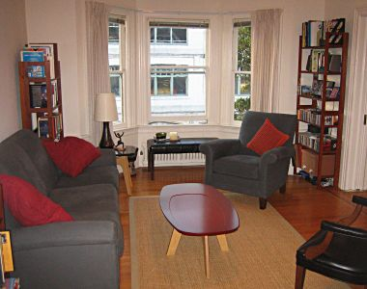


Housing
Share an apartment = $400
Share an apartment = $400
Rent an apartment = $700
Rent an apartment = $700
Buy a condo = $850
Buy a condo = $850
Buy a townhome = $1000

Slide 15
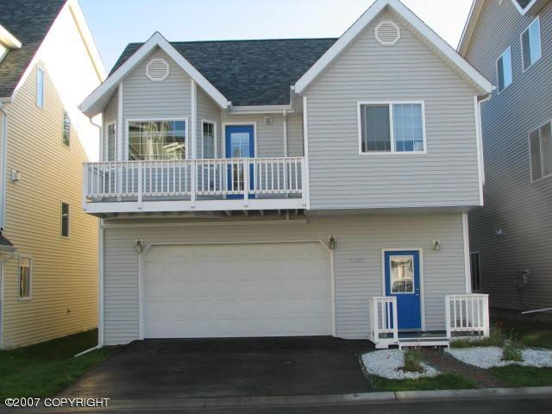

Housing
Buy a luxury home = $1500
Buy a house = $1200

Slide 16

Transportation Choices
Depending on others
Taking the bus
Buying used car (+ insurance & fuel)
Buying used truck/suv (+ insurance & fuel)
Buying new car (+ insurance & fuel)
Buying a new truck/suv (+ insurance & fuel)
Buying a luxury automobile (+ insurance & fuel)

Slide 17

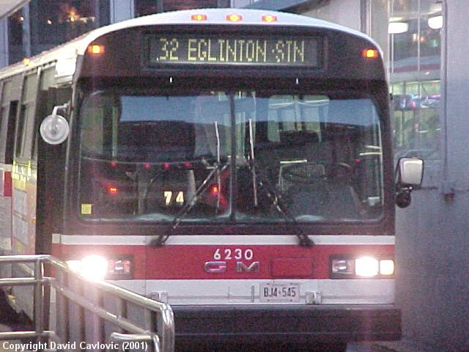
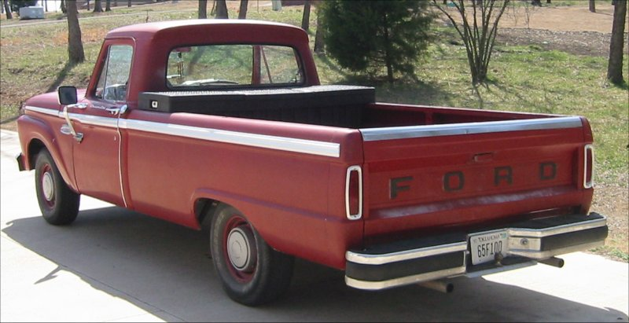
Transportation
Walking or
Depending on
Others = $0
Buy used car = $200
Using public transit = $50
Buy a used truck/suv = $250
Remember buying a vehicle means
You are paying for the cost of the vehicle,
Insurance and fuel every month.

Slide 18
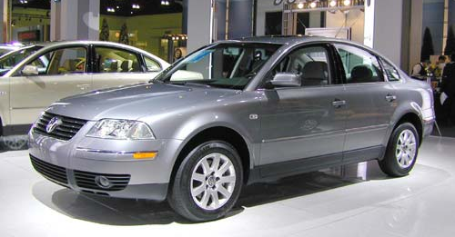


Transportation
Buy a sedan/coupe = $300
Remember buying a vehicle means
You are paying for the cost of the vehicle,
Insurance and fuel every month.
Buy a luxury car/sports car = $500
Buy a new truck/suv = $400

Slide 19



Clothing
Off Brand Clothing = $50
Designer Clothing = $200
Brand Name Clothing = $100

Slide 20




Electronics
Flat Screen HDTV = $100
Game System &
On-Line Subscription
= $50
Laptop Computer = $100
iPod with
iTunes = $20

Slide 21




Other Items
Snowmobile or 4-Wheeler = $200
Camper = $300
Fast Food
= $50
Fine Dining
=$150

Slide 22




More Items
Gourmet
Coffee
=$50
Domestic Travel = $200
Foreign Travel = $400
Downhill
Skiing = $50
Riverboat = $300

Slide 23
Do the Math!
Add up your Total Shopping Cost and make sure it is less than the Spendable Income figure – if it is not adjust it until you are at $0 or have some left in Savings
When do you plan on retiring?

